Slide 1
Android UI
By
Dexter

Slide 2
Everything is a view
Everything is a view in Android
Text
Image Button

Slide 3
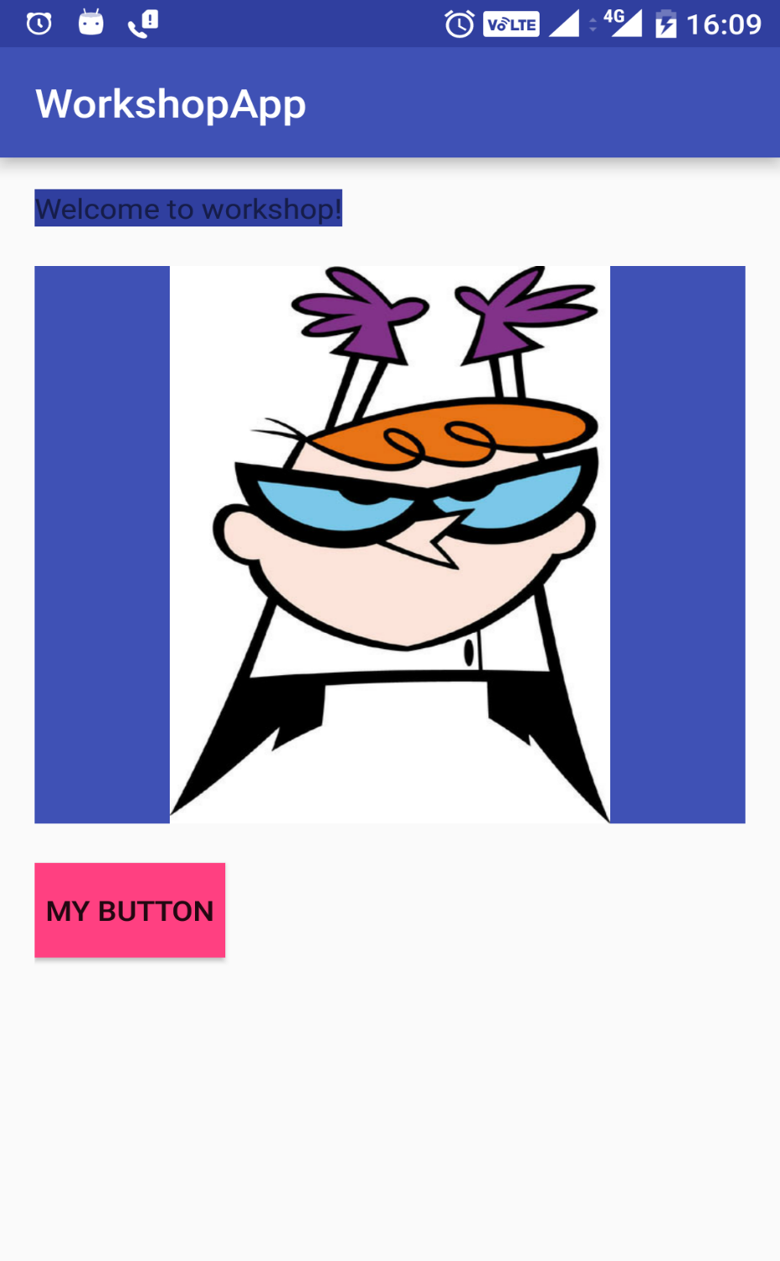
Everything is a view
Everything is a view in Android

Slide 4
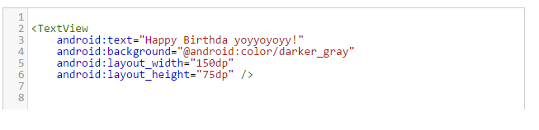
View Details
Named in camelCase
TextView , ImageView, Button

Slide 5
Tag explained
Name of the tag
Properties of tag – gives behaviour same as person
Closing tag
Self Closing

Slide 6
TextView
<TextView
android:text="Welcome to work shop!"
android:background="@android:color/darker_gray"
android:layout_width="150dp"
android:layout_height="75dp" />
Some properties of tag are set by default

Slide 7
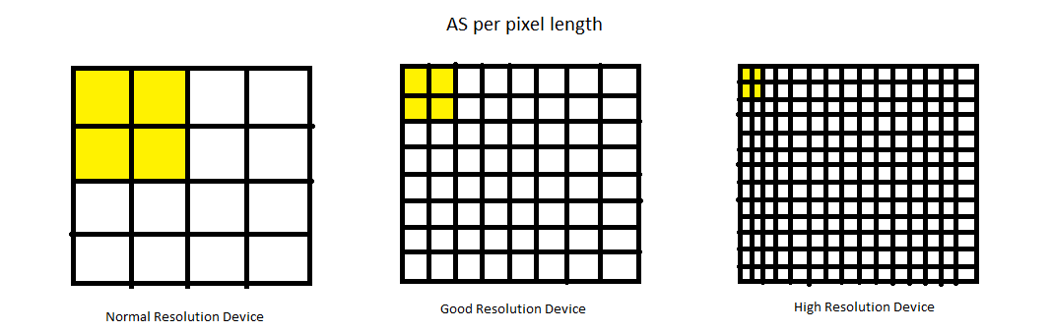
DP = Density Independent Pixel

Slide 8
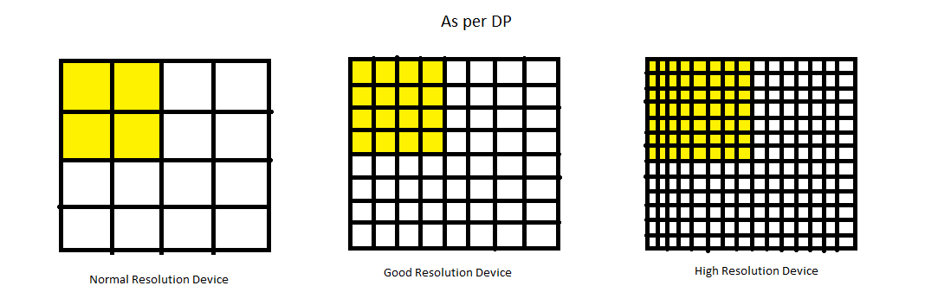
DP = Density Independent Pixel

Slide 9
DP
Different no. of pixel in same space
About the fixed height and width
How to use wrap_content

Slide 10
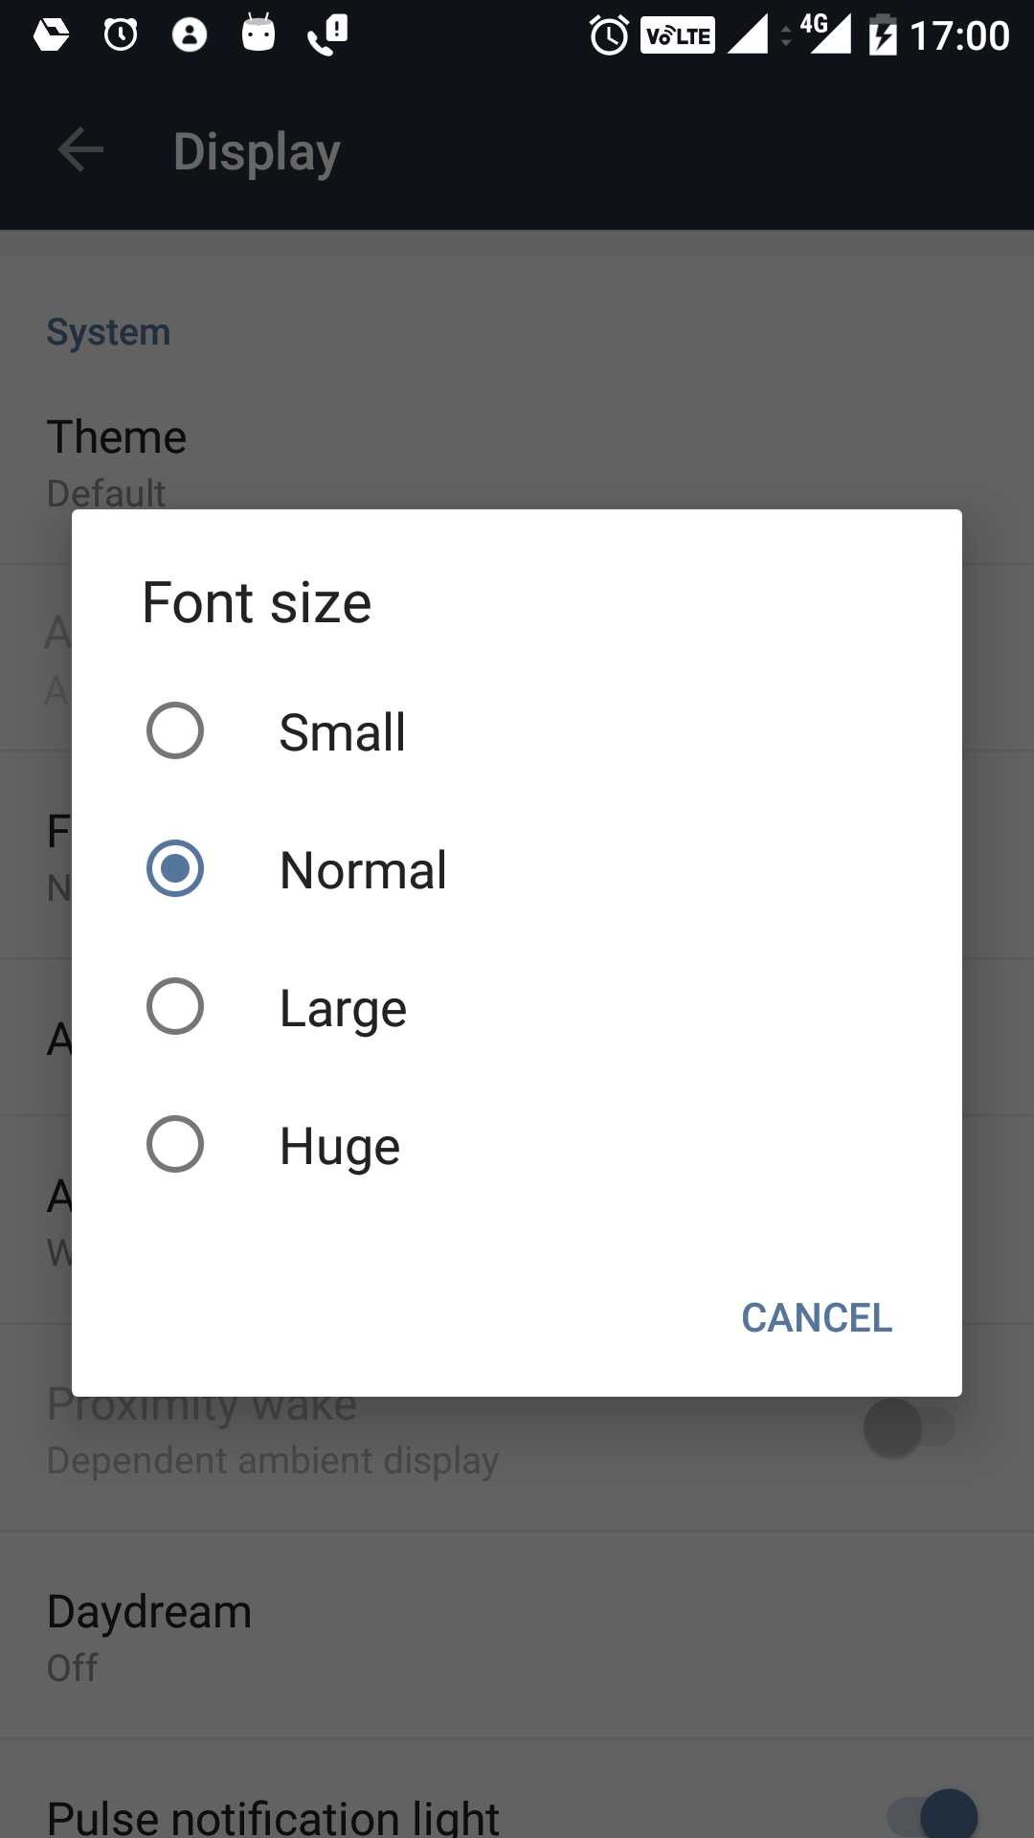
SP = scalable pixel
Device font set according
to user preferences
Hence scalable pixel

Slide 11
Theme setting
Only choose 4-5 text sizes to show
Google font
4-5 colours that go well with Theme
Material Design colours

Slide 12
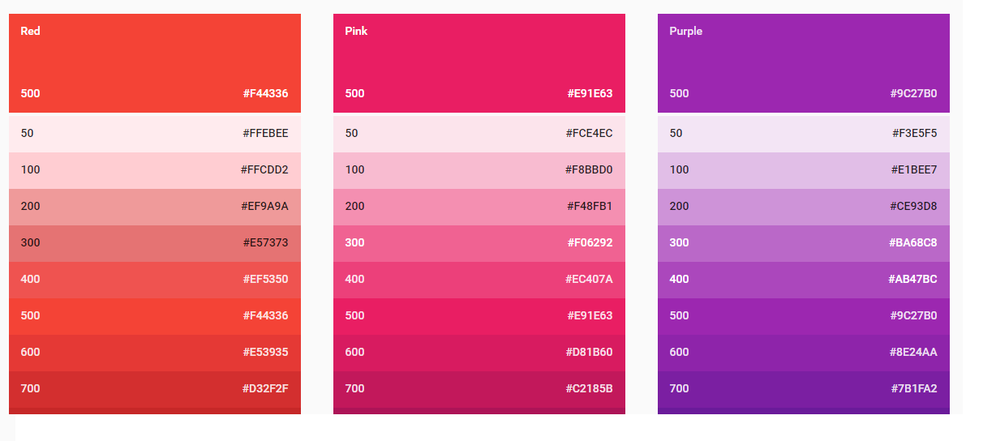
Theme setting

Slide 13
Theme setting
Default size given by android as
Android:textAppearance = “?android:textAppearanceMedium”

Slide 14
ImageView
ImageView needs android:src
Image scaleType => center / crop_center

Slide 15
ImageView
Always use image as resource
<ImageView
android:id="@+id/photo_image_view"
android:layout_width="match_parent"
android:layout_height="match_parent"
android:scaleType="centerCrop"
android:src="@drawable/beach" />

Slide 16
Layouts
RelativeLayout
LinearLayout
Parent View
Child View

Slide 17
LinearLayout
Place views in linear fashion
Vertical
Horizontal

Slide 18
RelativeLayout
Place views relative to Parent
Place views relative to each other

Slide 19
Questions
Which layout to use ?

